Slide 1


A global federation of interoperable data repositories
Matthew B. Jones
National Center for Ecological Analysis and Synthesis
University of California Santa Barbara
@metamattj
jones@nceas.ucsb.edu
0000-0003-0077-4738
March 8, 2015 Research Data Alliance

Slide 2
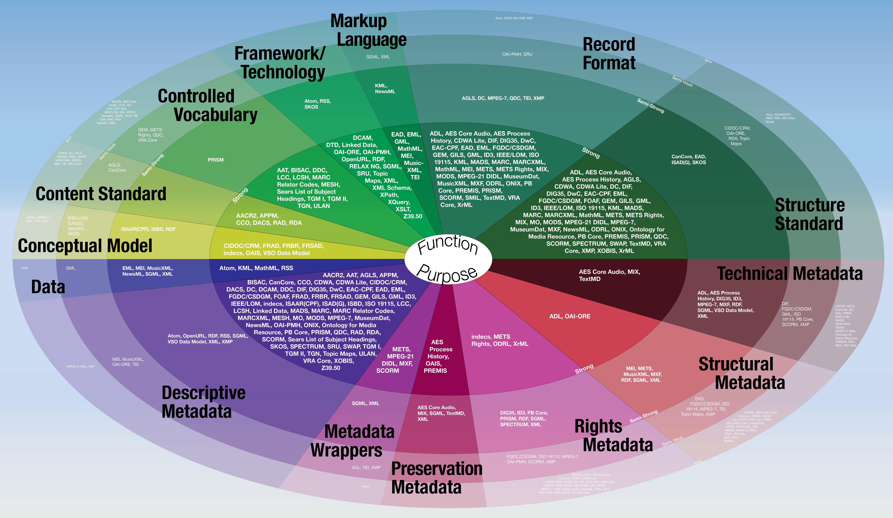
Diverse data and standards
Riley and Becker. 2009. Seeing Standards.

Slide 3
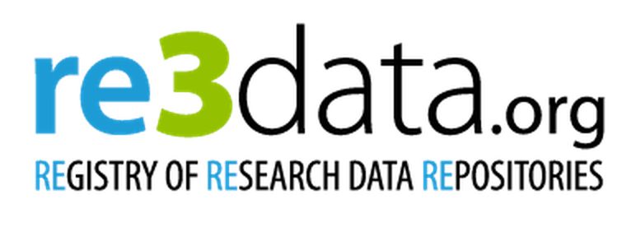
Diverse institutions
Over 1000 repositories registered
Life sciences: 562
85 for “Ecology”
Natural Sciences: 566
Humanities and Social Science: 329
Engineering Sciences: 134

Slide 4








Diverse software
OPeNDAP

Slide 5

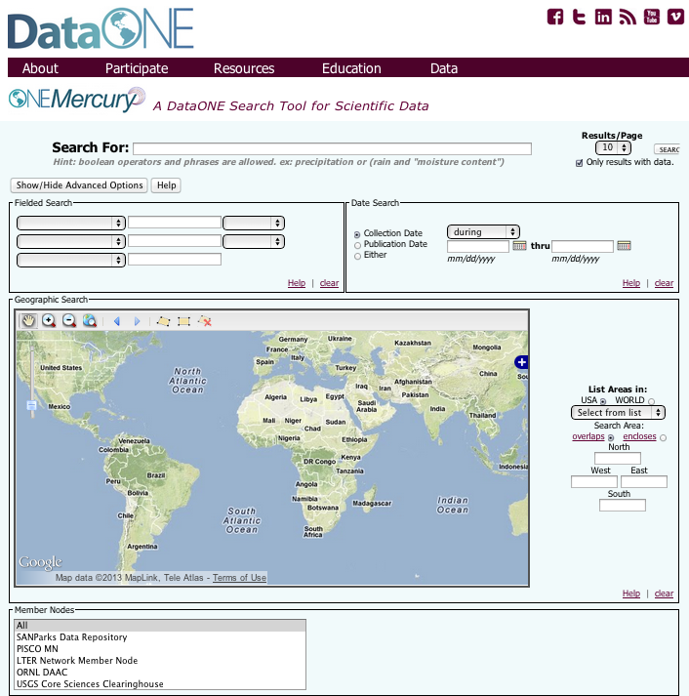












The DataONE Vision and Approach
Facilitating long term access to earth sciences data through infrastructure, tools, and education.
1. Build community
2. Develop sustainable data discovery and interoperability solutions
3. Enable science through tools and services
Plan
Analyze
Collect
Integrate
Assure
Discover
Describe
Preserve

Slide 6
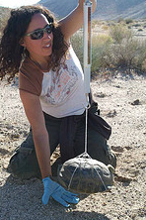

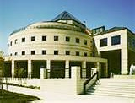
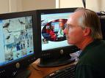


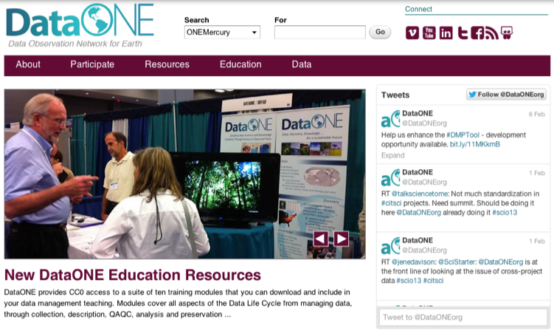

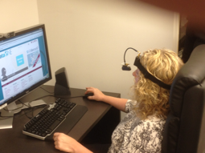
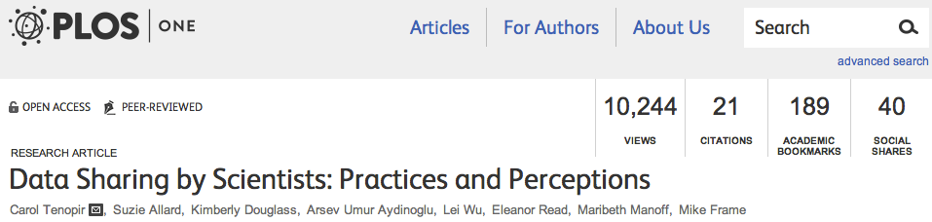
Working with our Community
stakeholder surveys
persona and scenario development
cyberinfrastructure development
libraries &
librarians
data managers
scientists
usability testing
external assessments / surveys

Slide 7



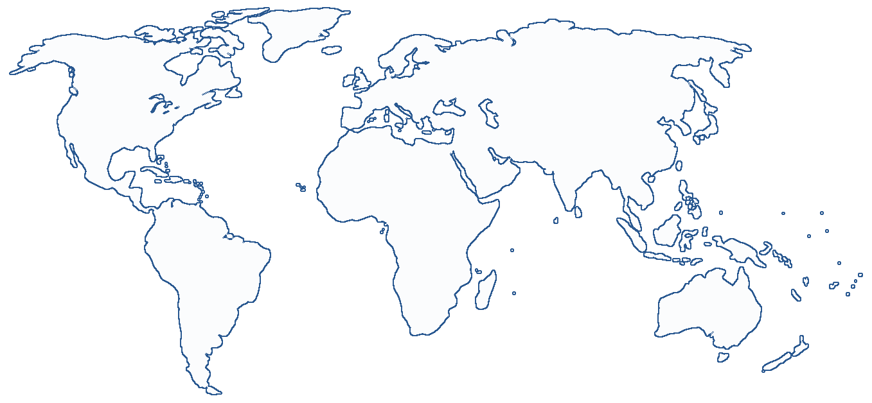



DataONE: Cyberinfrastructure
Three major components for a flexible, scalable, sustainable network
Coordinating Nodes
metadata catalog
search and discovery
network-wide services
preservation services
replication services
Notes:
Need to update with new / upcoming MN locations

Slide 8

















DataONE: Cyberinfrastructure
Three major components for a flexible, scalable, sustainable network
Coordinating Nodes
retain complete metadata catalog
indexing for search
network-wide services
ensure content availability (preservation)
replication services
Member Nodes
diverse institutions
serve local community
provide resources for managing their data
retain copies of data
Notes:
Need to update with new / upcoming MN locations and logos

Slide 9
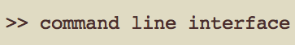















DataONE: Infrastructure and Tools
Three major components for a flexible, scalable, sustainable network
Coordinating Nodes
retain complete metadata catalog
indexing for search
network-wide services
ensure content availability (preservation)
replication services
Member Nodes
diverse institutions
serve local community
provide resources for managing their data
retain copies of data
Investigator Toolkit
Notes:
Need to update with new / upcoming MN locations and logos

Slide 10
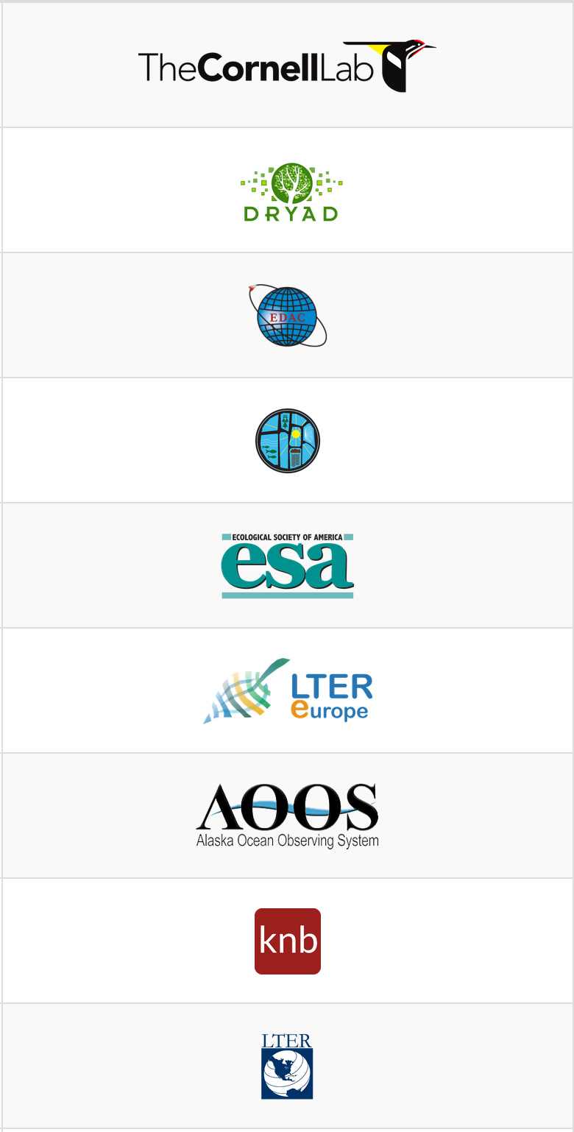
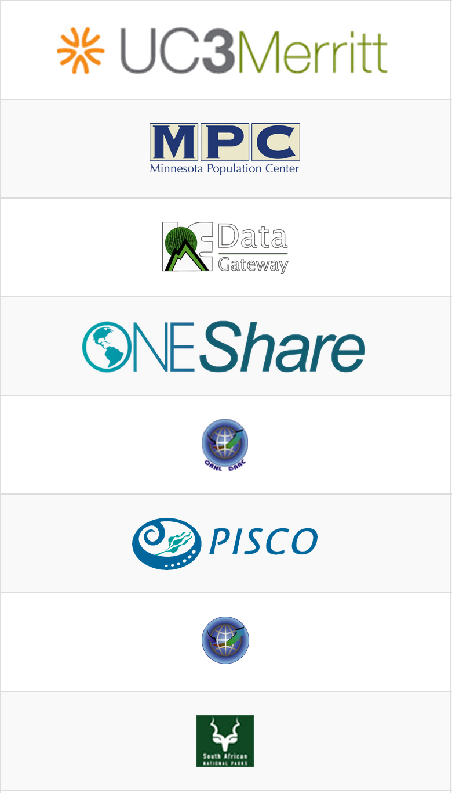

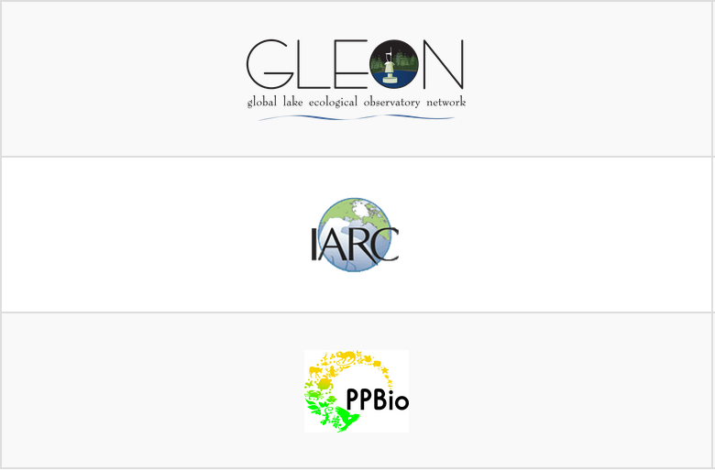
25 DataONE Repository Members
North America (21), Europe (1), Africa (1), Asia (1), South America (1)

Slide 11





Creating Interoperability
Member Nodes (MNs)
Authoritative data stores
Harness the power of local curation
Coordinating Nodes (CNs)
Services to link Member Nodes
REST APIs
Investigator Toolkit (ITK)
Tools for the whole data lifecycle
Interoperability
API

Slide 12
Service API as glue
Investigator Toolkit
Data Discovery
Analysis, Visualization
Data Management
Java Library
Python Library
CLI Tools
REST URLs
Service API Specifications
Member Nodes
Coordinating Nodes
Service Interfaces
Service Interfaces
Read
Authorize
Search
Resolve
Write
Replicate
Register
Replicate
Translate to MN Internals
Coordination Layer
Identify
Catalog
Data Repository
Preserve
Monitor
Object Store
Index
Notes:
? Why not use existing standards csw, oai-pmh. Issue is read and write. Will enable some of these services down the road. Consistent set of rest interfaces across the spectrum of MN needs.

Slide 13
Member Nodes
Authoritative members of the Federation
Curate data holdings
Provide unique identifiers for each object
Ensure availability, quality, and reliability
Replicate holdings for other MNs
Provide access and access control
Log and report accesses to objects
Engage with DataONE community
Deploy a DataONE-compatible software system

Slide 14
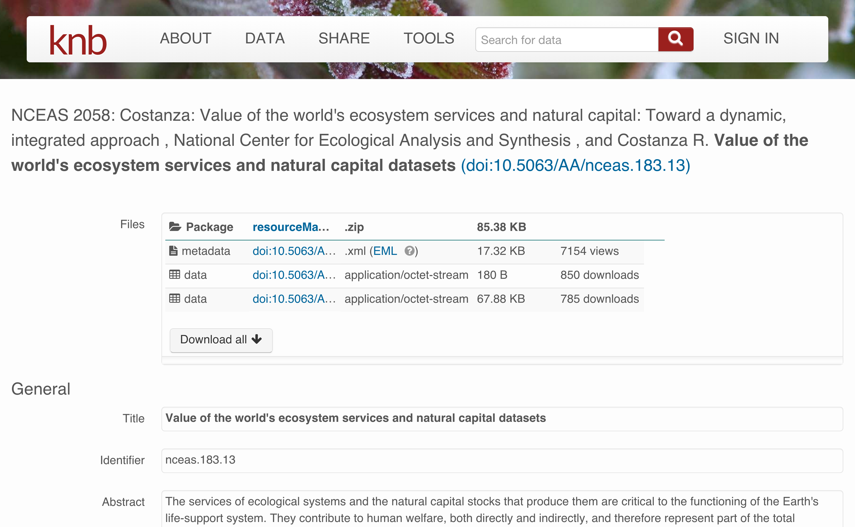
Citation and usage tracking

Slide 15
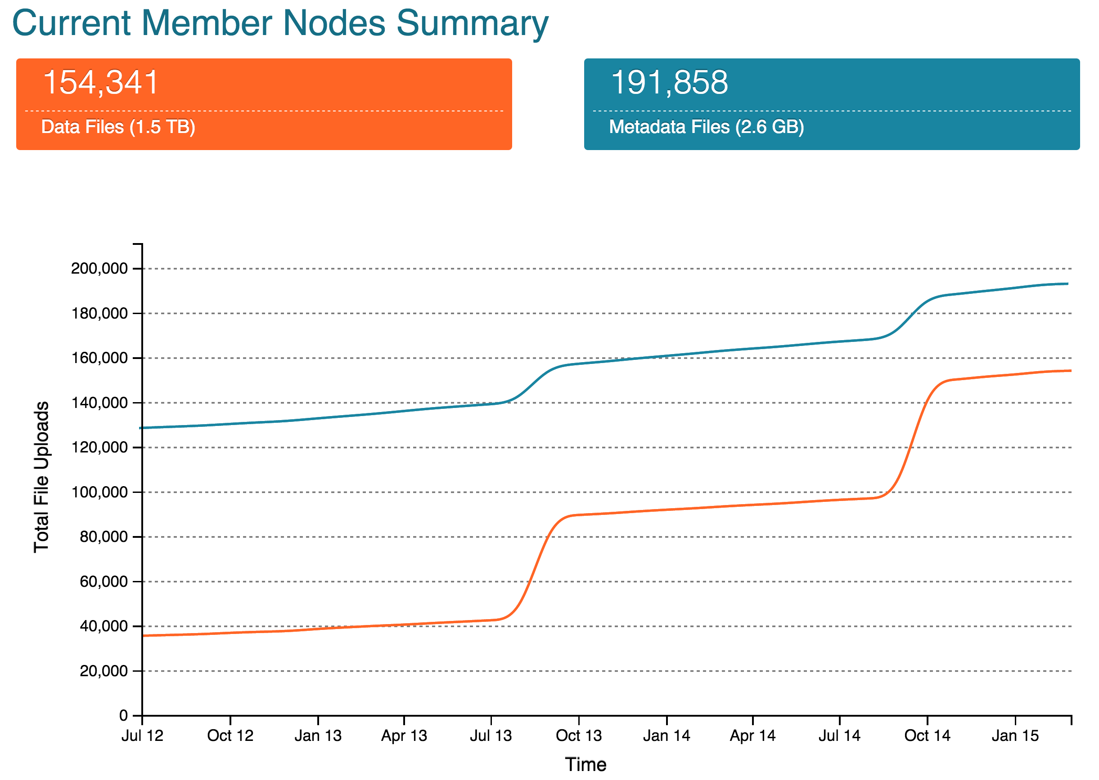

Slide 16
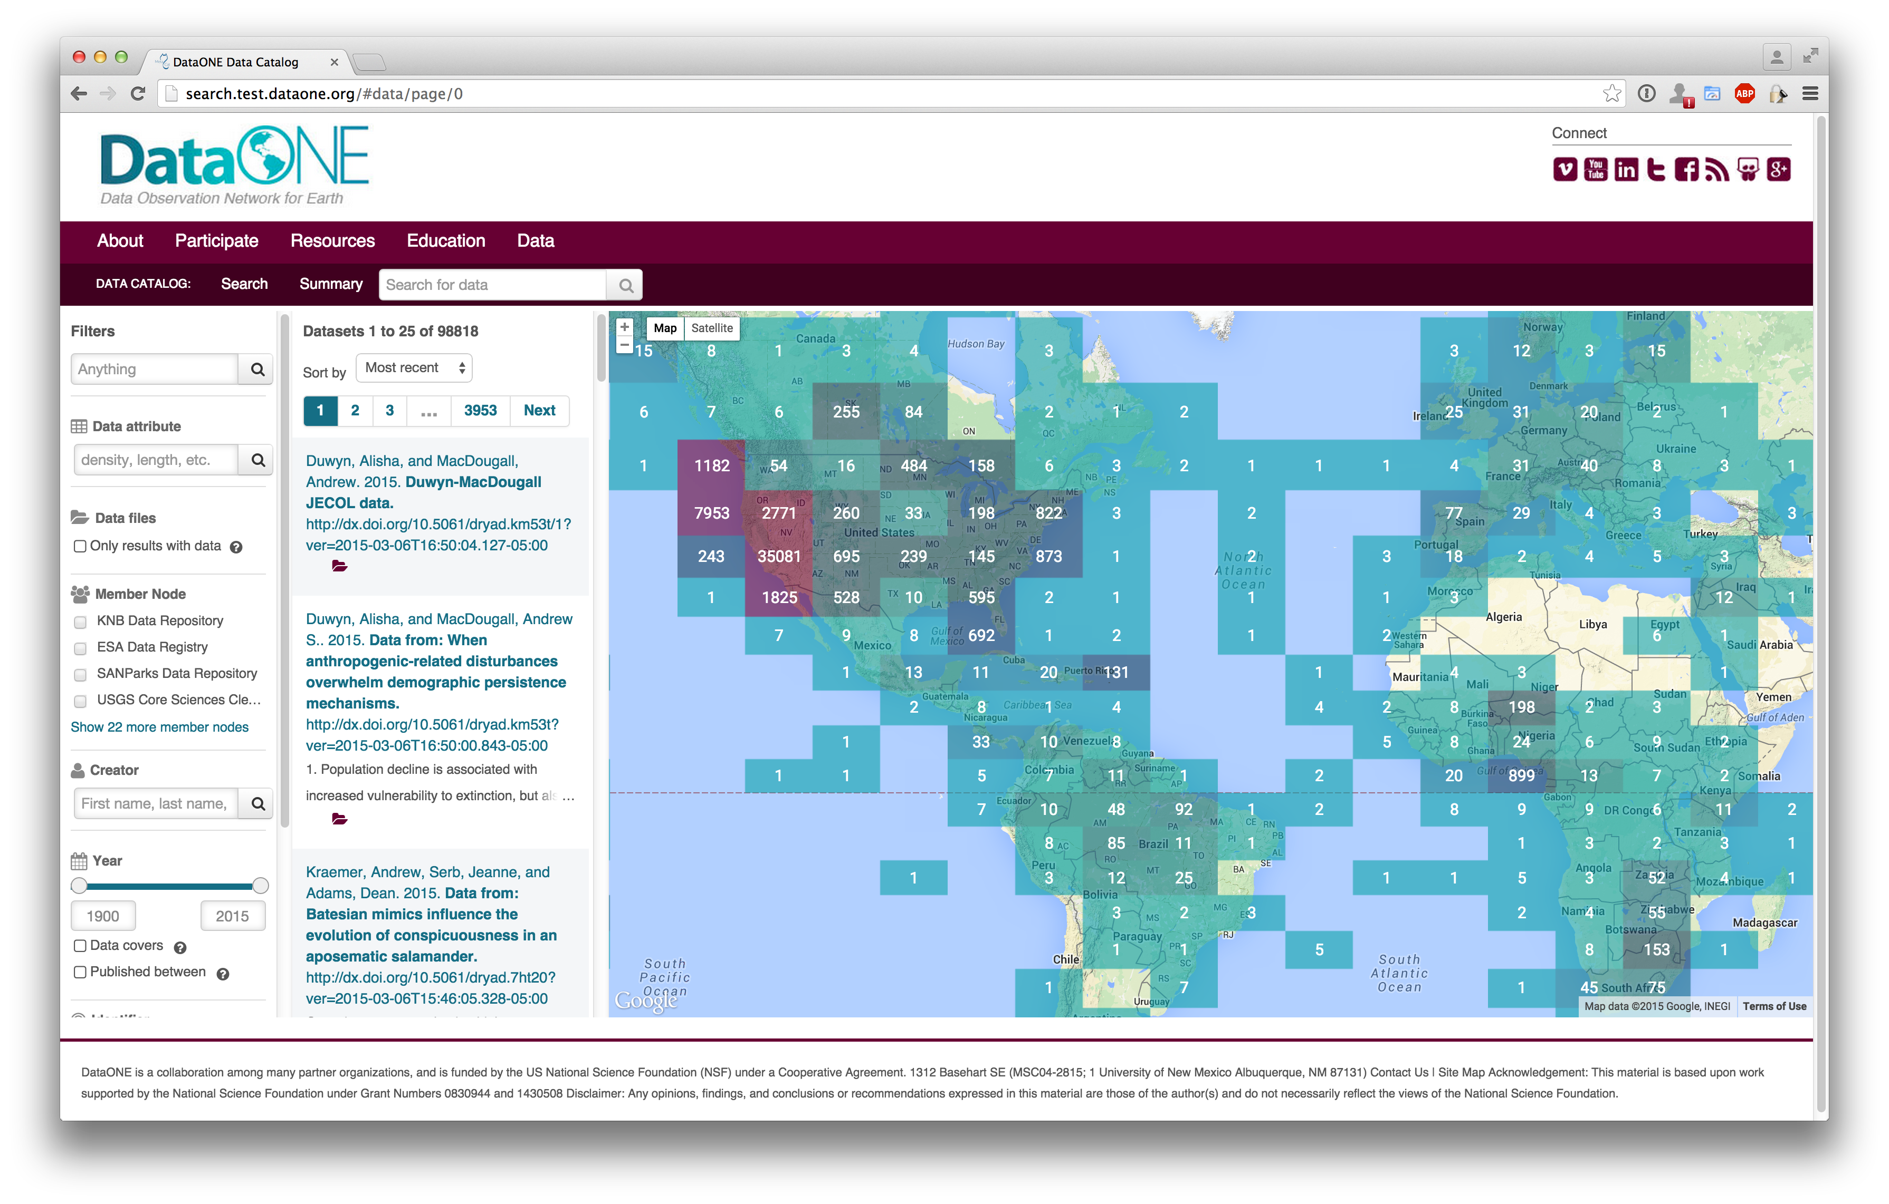
Data discovery

Slide 17
Provenance: time travel in DataONE
Phase II Goal: Facilitate reproducible science
Track data derivation history
Track data inputs and outputs of analyses
Track analysis and model executions
Preserve and document software
Link all of these to publications

Slide 18
Provenance at-a-glance
ProvONE extensions to W3C PROV
New first-class objects in DataONE
Figures
Software
Extended Data Package with Provenance
New Tools
Web user interface for browsing provenance
Matlab tool for generating provenance
R tool for generating provenance

Slide 19
New objects, ProvONE trace
system metadata
OAI-ORE resource map
system metadata
system metadata
science metadata
science data
system metadata
system metadata
software
figures
OAI-ORE with ProvONE trace

Slide 20
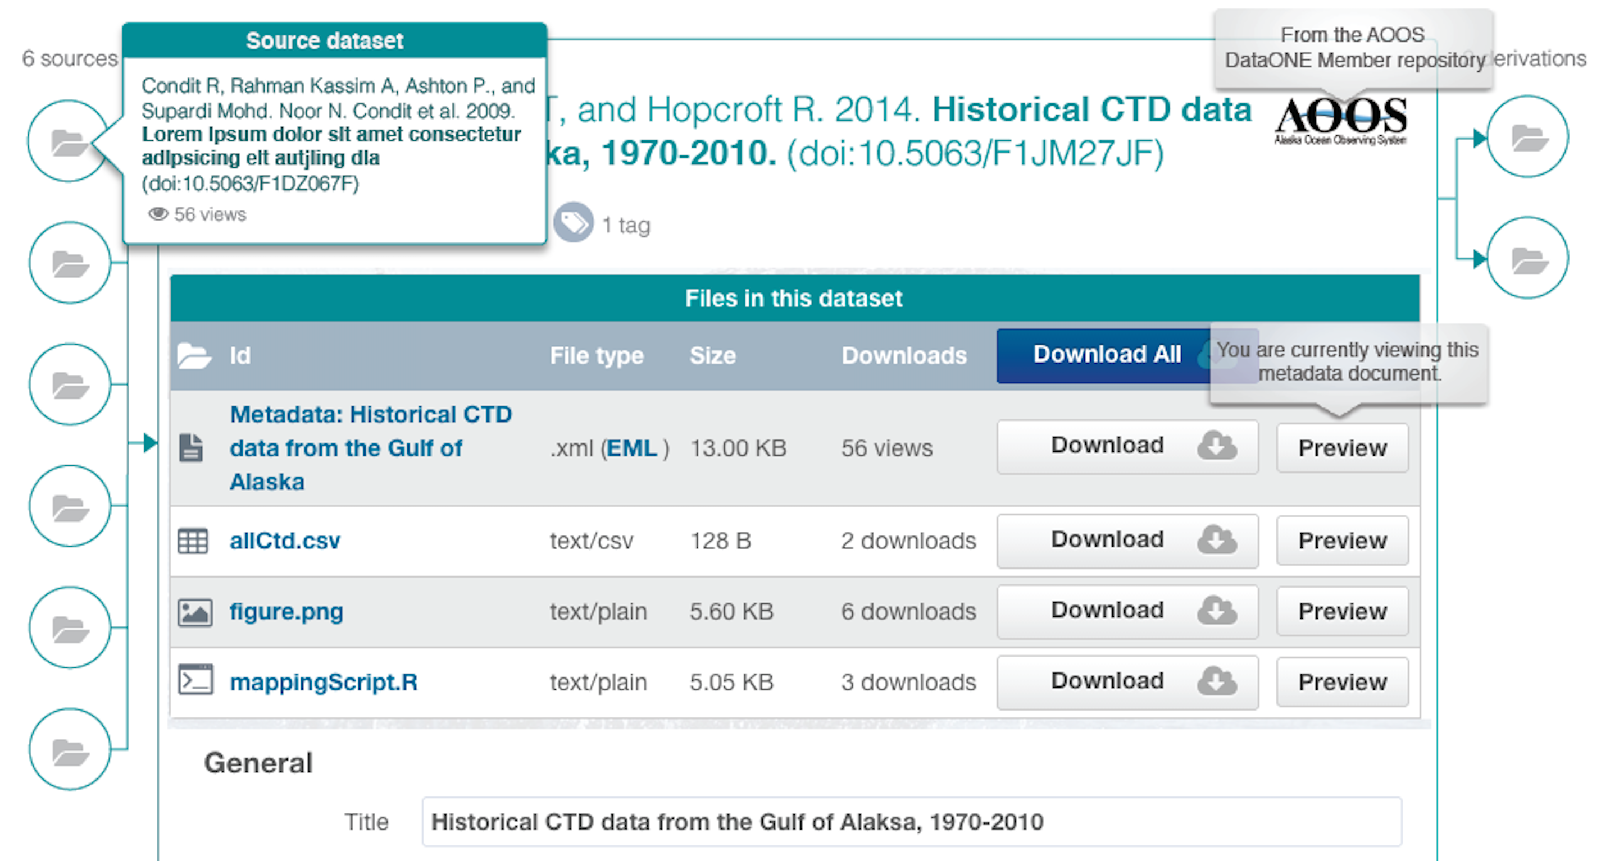
Provenance: Data derivation

Slide 21
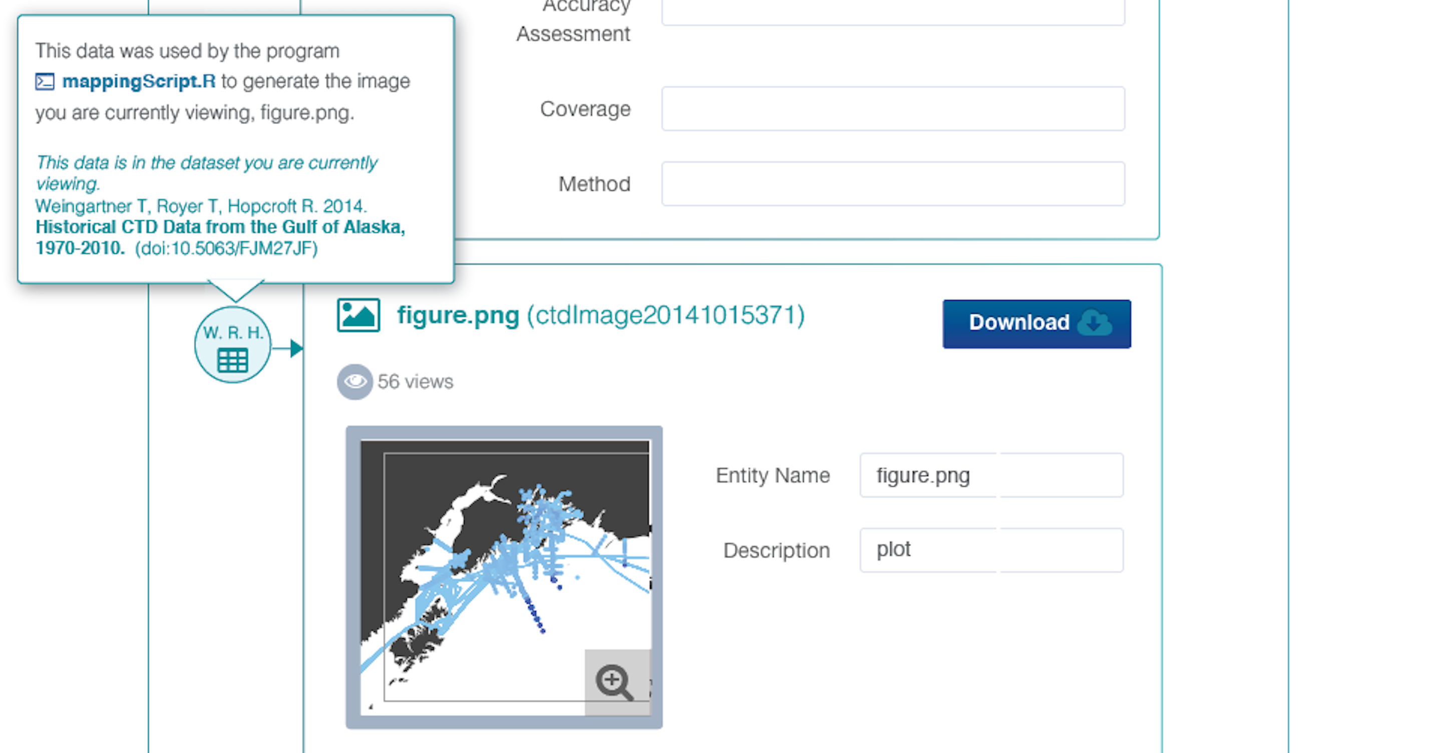
Provenance: Code execution

Slide 22
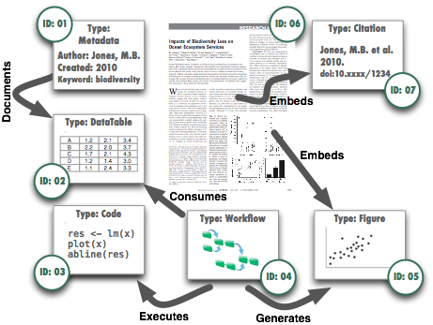
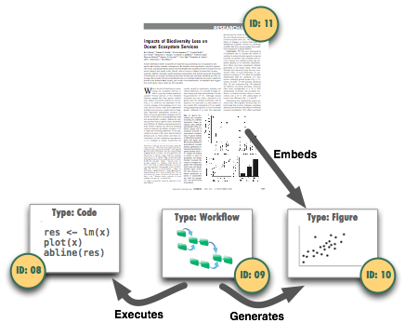
Publication: version 1
Publication: version 2
Replaces

Slide 23
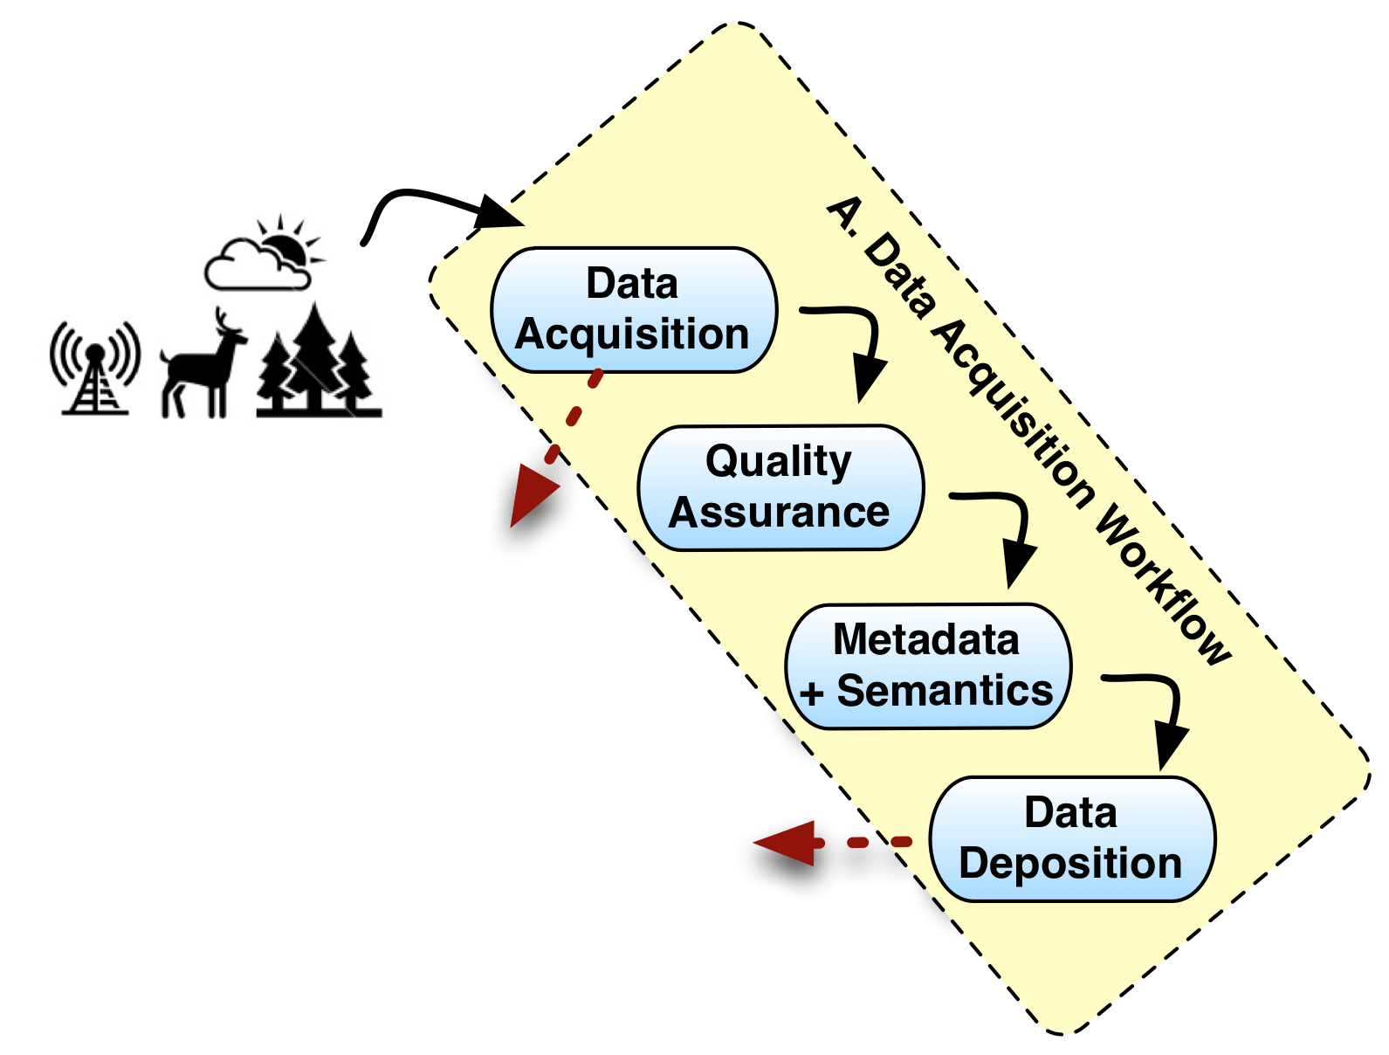
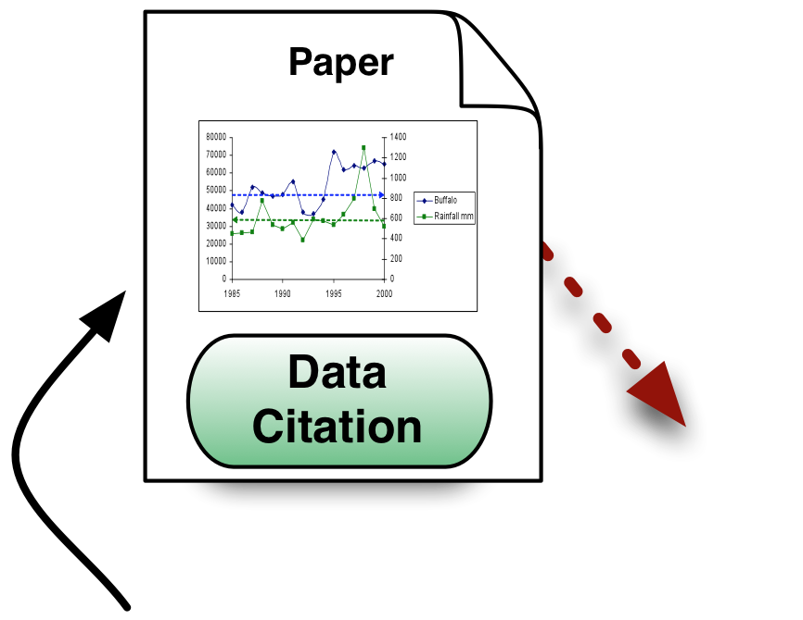



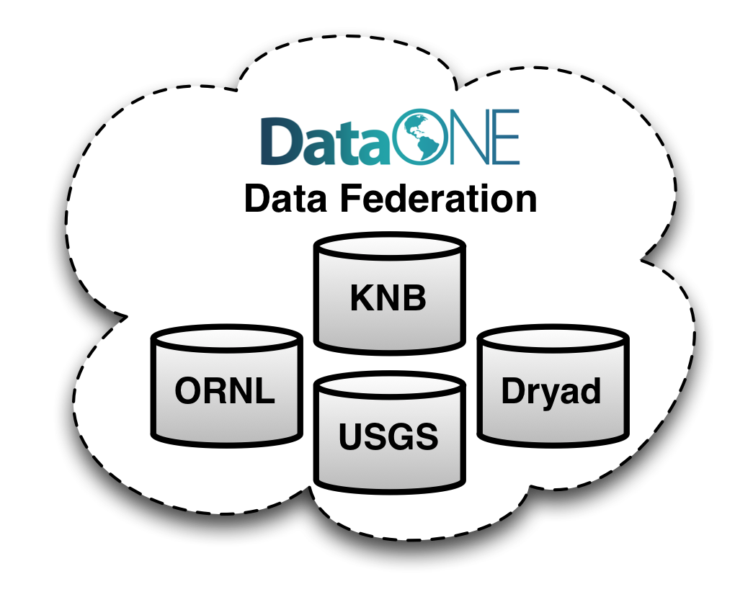
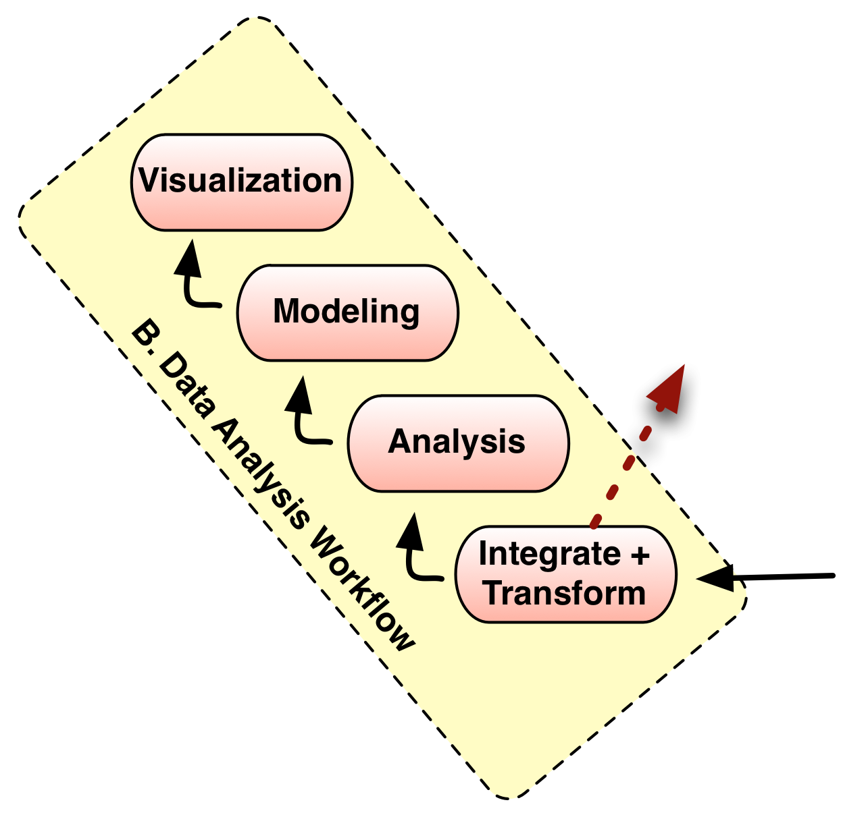

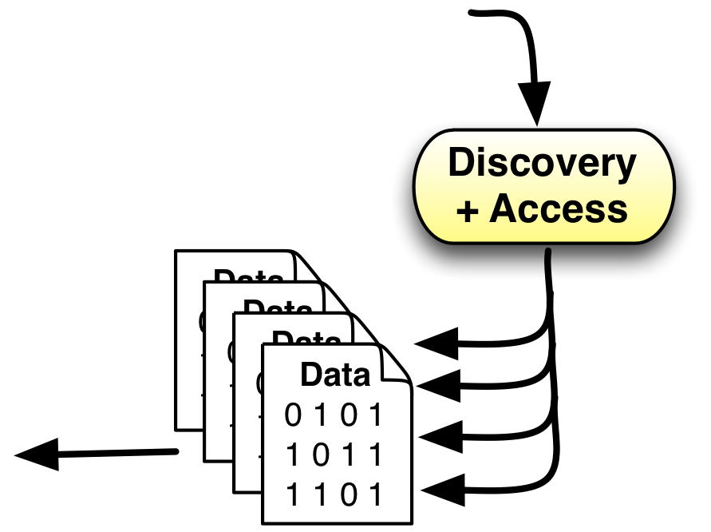


The science lifecycle
From Reichman, Jones, and Schildhauer;
doi:10.1126/science.1197962

Slide 24
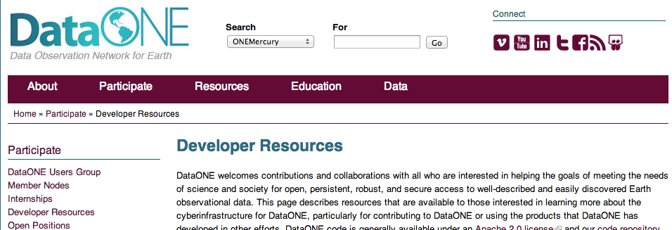
Resources
http://www.dataone.org
irc.ecoinformatics.org #dataone
developers@dataone.org
http://mule1.dataone.org/ArchitectureDocs-current/
Notes:
Workshop activities
Online resources
Education modules
Summer internship program
Postdoctoral program
Direct support for 7 graduate students
Affiliated research and training of 17 graduate and 40+ undergraduate students, student interns
Over 40 workshops in data management and related subjects
Events ranging from 20 to 200+ participants
Over 2,000 individuals reached
Example Targeted Workshops:
Data Management short course
Implementation of a DataONE MN software stack
Current Postdocs
Stacy Rebich Hespanha (CE)
Miriam Davis (CE)
Andrea Wiggins (CE)
Patrice Seyed (CI)
Victor Cuevas (CI)
Aritra Dasgupta (CI)
Previous Postdocs
Kimberly Douglass - Faculty, University of Tennessee
Carly Strasser - Project Manager, California Digital Library
Heather Piwowar - Founder, ImpactStory
DeWayne Branch - Postdoc, Purdue University
Direct support for 7 graduate students
Affiliated research and training of 17 graduate and 40+ undergraduate students
IMLS Data Curation Education in Research Centers Program
IMLS SciData
IMLS ScienceLinks²
2009 – 4 interns
2010 – 4 interns
2011 – 8 interns
2012 – 6 interns
2013 – 8 opportunities

Slide 25



























DataONE Team and Sponsors
Amber Budden, Roger Dahl, Rebecca Koskela, Bill Michener, Robert Nahf, Skye Roseboom, Mark Servilla
Ewa Deelman
Dave Vieglais
Deborah McGuinness
Suzie Allard, Kimberly Douglass, Laura Moyers, Carol Tenopir, Robert Waltz, Bruce Wilson
Jeff Horsburgh
John Cobb, Bob Cook, Ranjeet Devarakonda, Giri Palanismy, Line Pouchard
Robert Sandusky
Patricia Cruse, John Kunze
Bertram Ludaescher
Sky Bristol, Mike Frame, Richard Huffine, Viv Hutchison, Jeff Morisette, Jake Weltzin, Lisa Zolly
Peter Honeyman
Chris Jones, Matt Jones, Ben Leinfelder, Mark Schildhauer, Jing Tao, Lauren Walker, Peter Slaughter, {Stephanie Hampton, Chad Berkley, Andrew Pippin}
Cliff Duke
Carole Goble
Paul Allen, Rick Bonney, Steve Kelling
Jane Greenberg, Ryan Scherle, Todd Vision
Donald Hobern
Randy Butler
David DeRoure
Paolo Missier
LEON LEVY
FOUNDATION

Slide 26
Extra slides for the curious

Slide 27
Data Package: Metadata
system metadata
resource map
system metadata
system metadata
science metadata
science data
xml metadata:ISO, EML, FGDC, Dublin Core, etc.

Slide 28
Data Package: Data
system metadata
resource map
system metadata
system metadata
science metadata
science data
any data object:
text, binary, etc.

Slide 29
Data Package: Description
system metadata
resource map
system metadata
system metadata
science metadata
science data
OAI-ORE xml document

Slide 30
Data Provenance

Slide 31
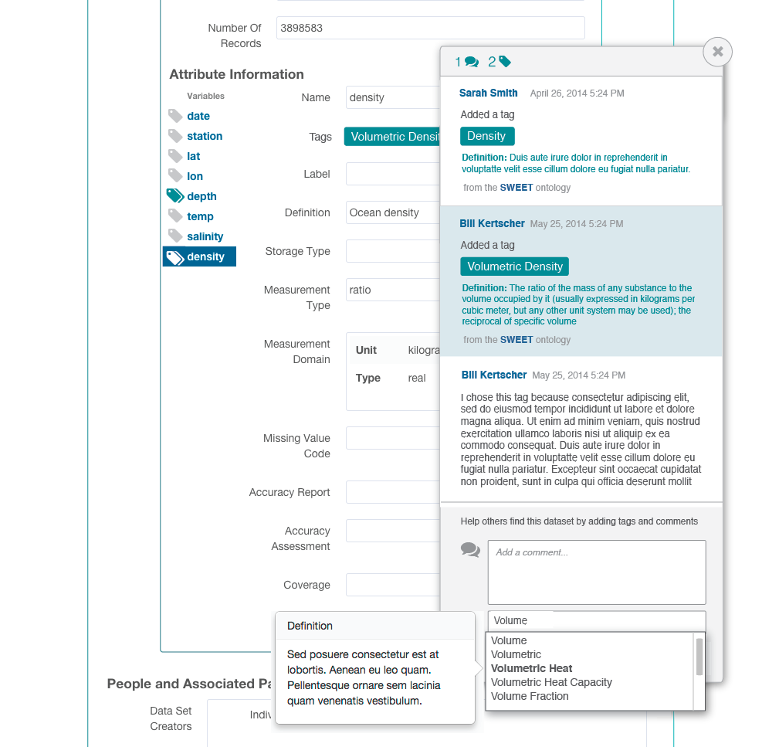
Data
Semantics

Slide 32
